Slide 1


ECEN 403 Midterm Presentation
Team 50: BioMetrix Simon Becker
Andrew-Joseph Nicolas
Lance Pagaduan
Harin Sankar
TA: Hailey Ward
Sponsor: Dr. Stephen Wright

Slide 2
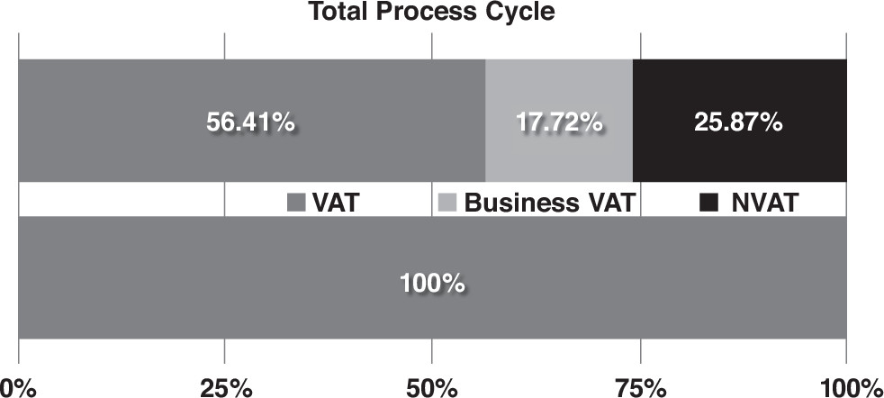
Contactless Cardiac Gating
Problem statement:
Current ECG-based cardiac gating is time-consuming, intrusive, and uncomfortable.
Our Solution:
Using Doppler radar technology to monitor cardiac movement improves patient throughput and comfort.
Figure 1.
MRI Utilization
From Optimizing MRI Logistics: Prospective Analysis of Performance, Efficiency, and Patient Throughput, by Beker, et. al., 2017

Slide 3
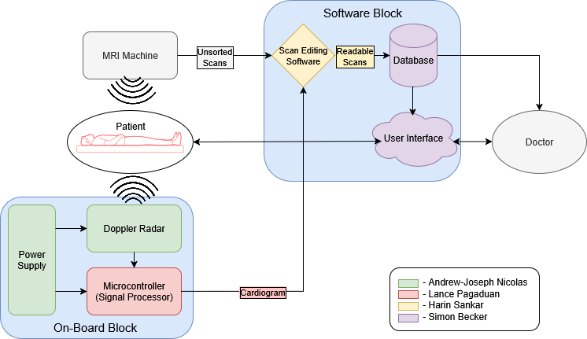
System Overview
Notes:
Cloud server and database

Slide 4
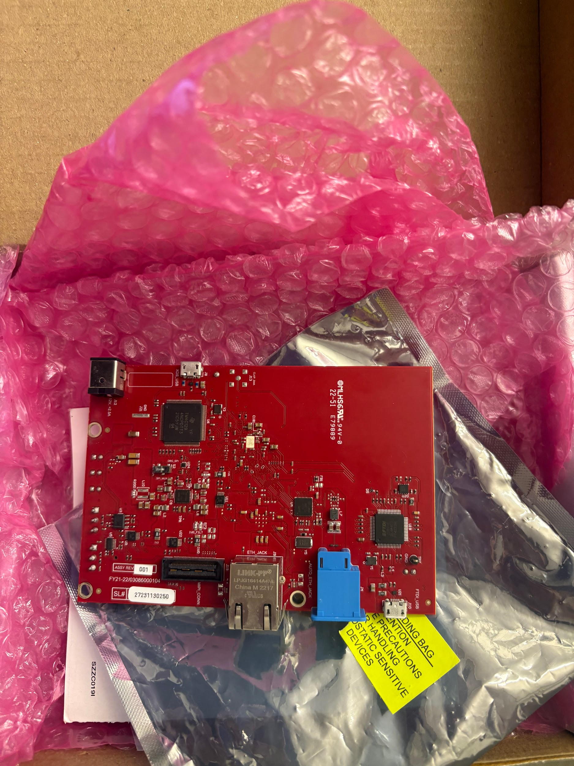
PCB – Andrew
Maintains consistent power distribution and handles radar input and output.
Multisim is being used to create and simulate the circuit and Altium is being used to create the PCB.
The main objectives are to take delicate output signals from the mmW radar and maintain integrity, as well as distribute power accordingly.
The main subsystem it is connected to is the MCU, as this is where the radar output signals will be sent to.
MmW Radar Sensor, 2 7.4V Li-ion batteries with BMS, and non-ferromagnetic PCB are the main parts of this subsystem.

Slide 5
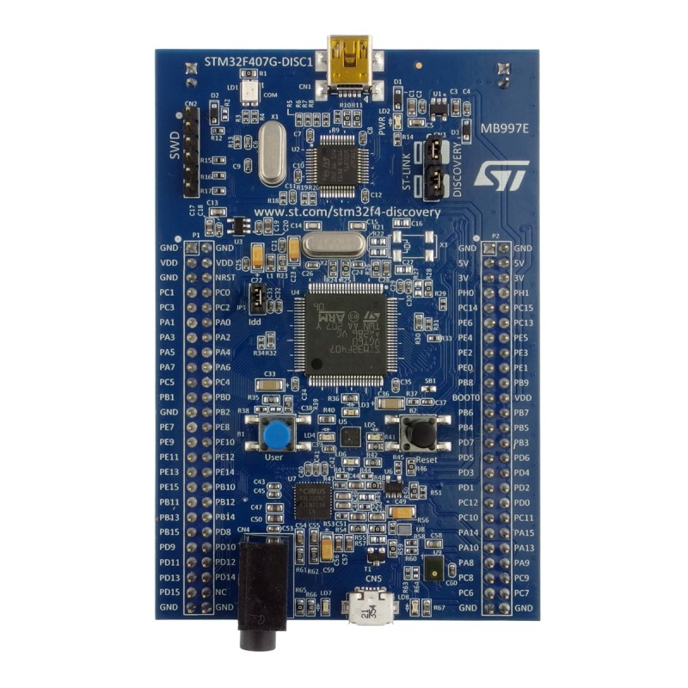
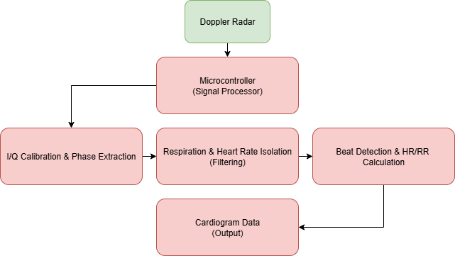
Microcontroller Unit (MCU) – Lance
Takes doppler radar input and outputs cardiogram.
Filters radar signals and divides signals into Heart rate (HR) and Respiration rate (RR).
MCU:STM32F407G, Simulation: MATLAB, Embedded software: STM32Cube IDE.
Requires clean doppler signal input, must amplify/separate signal outputs.
Compares cardiogram data with MRI scan.

Slide 6
Scan Filter – Harin
Cardiac Steady State Identifier
Cardiogram
Temporal Synchronizer
MRI Filter
Filtered MRI Scans
MRI Scans
Compares cardiogram data with MRI scan timestamps temporally to filter out unusable MRI scans.
Developed in Python using libraries such as pydicom, pandas, numpy, ext.
Provides accurate scan filtering, with constraints from the DICOM standard and abnormalities in cardiogram
Receives input from the MCU subsystem and MRI machine, then outputs usable scans to the database subsystem.
Python environment: medical libraries, ease of development, and integration

Slide 7
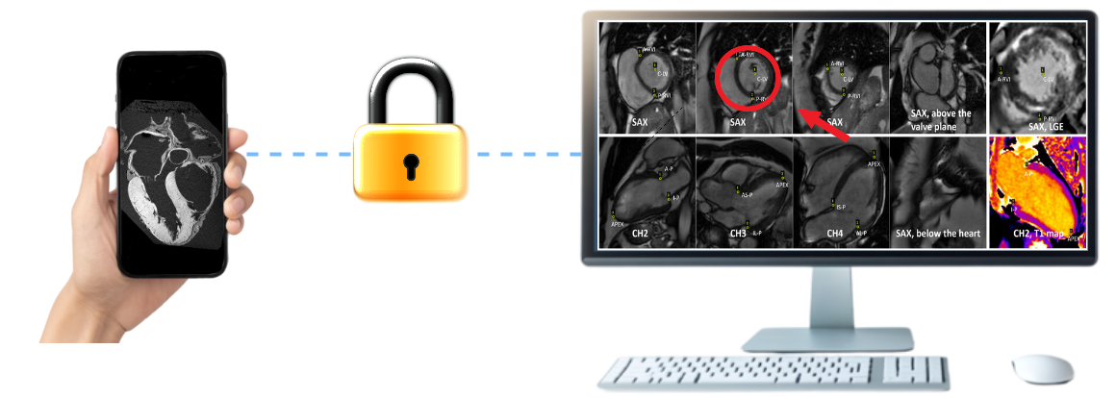
User Interface – Simon Becker
Connects patients and providers
Gives a space for medical providers to markup and comment on scans
Empowers patients by giving them transparent access to medical documents
Built for Windows in C# and encrypted
Secure, Transparent, Easy to Use, HIPAA Compliant
Will take the data provided by the Scan Editing Software
Includes radar targeting system

Slide 8
Project Execution & Validation
Accomplished so far and key planned engineering milestones
 | 10/1 - today | 10/7 | 10/21 | 11/4 | 11/17
PCB Andrew Nicolas | Design supporting circuit. | Create PCB based on circuit simulations and attach supporting components. | Test physical hardware and ensure integrity. | Test fully integrated power supply and PCB. | Validate signal integrity, power distribution, and general functionality.
MCU Lance Pagaduan | Acquire MCU & dev board along with simulation software | Gather sample data & be half complete with design of filter simulations | Test simulation data with samples, begin design filters on MCU | Test MCU & compare with simulation data using samples | Programmed MCU will output correct data based on simulations
Scan Filter Harin Sankar | Design data flow and code planning for MRI and gating comparison | Design code which outputs steady states in cardiogram | Test cardiogram analysis with sample cardiograms and design MRI-cardio comparator | Test MRI-cardio comparator and design code to output a interpretable filtered MRI scan | Validate all blocks for accuracy, precision, and test input ECG and MRI samples
User Interface Simon Becker | Complete front- and back-end plan | Write desktop application | Test desktop app, build server and web-app | Test web-app and server communication | Desktop app transfers data through server to web-app

